Slide 1
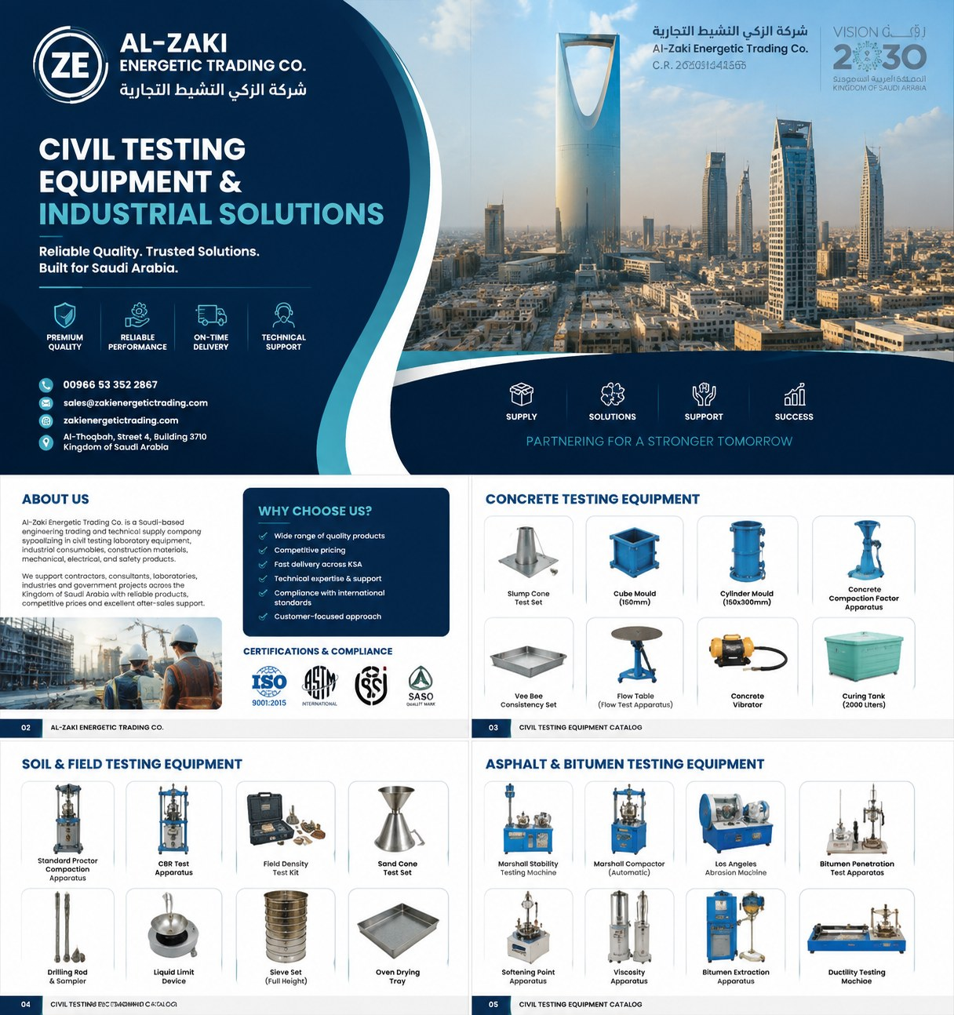

COMPANY PROFILE &
PRODUCT CATALOGUE
Engineering Solutions • Industrial Trading • Technical Supply
Reliable Quality. Trusted Solutions. Built for Saudi Arabia.
Founded 2003 | C.R. 2051242658 | Al Khobar, Saudi Arabia
For RFQs: share product, specification/grade, quantity, delivery destination, and required documents.
sales@zakienergetictrading.com | +966 53 352 2867

Slide 2

Al-Zaki Energetic Trading Co.
شركة الذكي النشيط التجارية | C.R. 2051242658
Company Snapshot
Saudi-based industrial trading and technical supply partner for contractors, laboratories, manufacturers, and engineering teams.
Who We Are
Established Presence
How We Support
Al-Zaki Energetic Trading Co. specializes in engineering solutions, industrial trading, and technical supply services across construction, manufacturing, infrastructure, quality-control and laboratory sectors.
Founded in 2003, the business built its reputation through reliable supply of building materials, fasteners, wire mesh, shim plates, hardware, safety items and specialized industrial products.
Sourcing, bulk supply, technical product matching, supplier documentation, logistics coordination, tender-ready RFQ support and practical after-sales follow-up.
Core Strengths
Industries Served
Procurement Promise
✓ Quality-focused sourcing
✓ Responsive quotation process
✓ Saudi/GCC procurement awareness
✓ Wide industrial category range
✓ Construction & civil works
✓ Industrial plants & workshops
✓ Material testing laboratories
✓ Warehouse and maintenance teams
✓ Clear specifications
✓ Practical technical support
✓ Timely delivery coordination
✓ Long-term supply relationship
tahir@zakienergetictrading.com | faseeh@zakienergetictrading.com | sales@zakienergetictrading.com | +966 53 352 2867 | +966 55 535 9645 | www.zakienergetictrading.com
02

Slide 3
Al-Zaki Energetic Trading Co.
شركة الذكي النشيط التجارية | C.R. 2051242658
Product Portfolio Map
A broad procurement platform covering civil testing equipment, industrial items, instrumentation, fabrication, safety and general supply.
Civil Lab & Material Testing
Fasteners, Mesh & Metal Materials
Mechanical Components & Fittings
Instrumentation & Automation
Concrete, cement, aggregate, soil, bitumen, asphalt and general lab applications.
Bolts, anchors, wire mesh, binding wires, shim plates, bars, tubes and straps.
Air fittings, valves, pipe fittings, tank mountings, accessories and hardware.
Pressure/temperature gauges, sensors, switches, transmitters, controllers and portable meters.
Fabrication & Civil Works Support
HVAC & Plant Accessories
Safety, Lifting & Site Supplies
Office & General Supplies
Machine foundations, metal fabrication, civil work supply and fabricated products.
HVAC items, valves, fittings, measuring instruments and plant consumables.
PPE, lifting items, slings, shackles, hooks, chains, safety consumables.
Office equipment, labels, tags, consumables and general procurement support.
Buyers can send product name / application, required standard, size/range, brand preference, quantity, delivery location and required certificates. We respond with clear quotation conditions, lead time, origin and documentation options.
One supplier. Multiple categories. Technical clarity from inquiry to delivery.
tahir@zakienergetictrading.com | faseeh@zakienergetictrading.com | sales@zakienergetictrading.com | +966 53 352 2867 | +966 55 535 9645 | www.zakienergetictrading.com
03

Slide 4
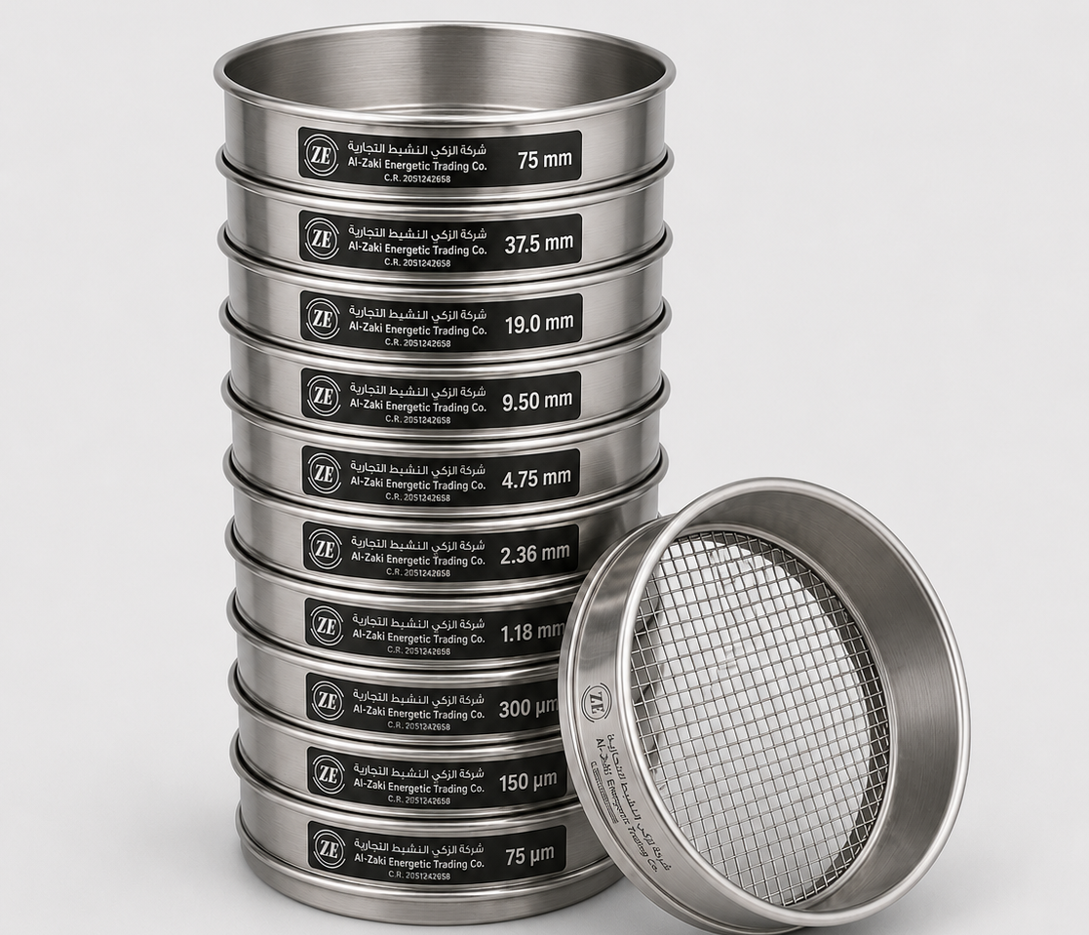
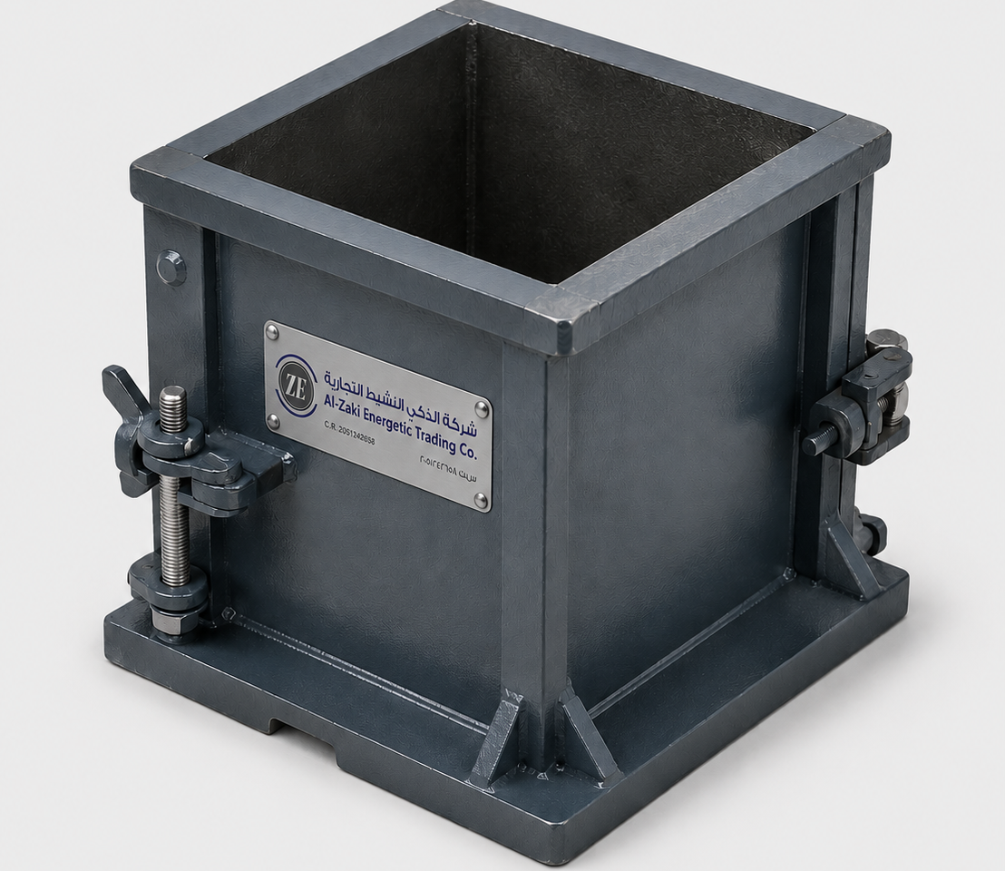
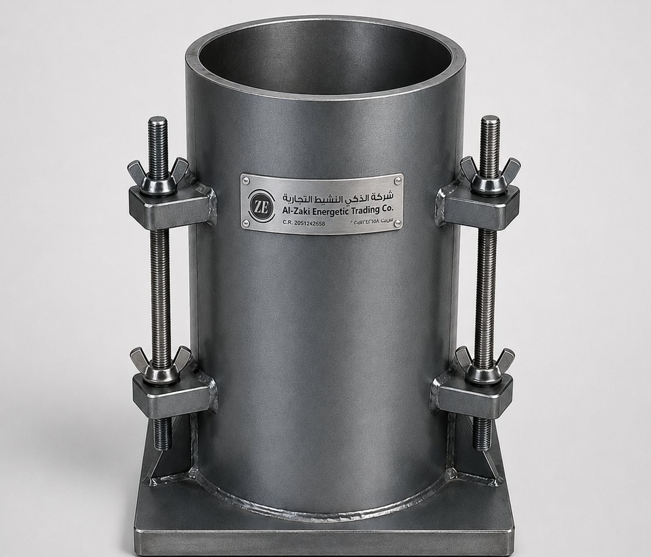

Al-Zaki Energetic Trading Co.
شركة الذكي النشيط التجارية | C.R. 2051242658
Testing Moulds, Sieves and Sample Tins
Civil Testing Laboratory Equipment
ZE
Sieve Set
ZE
Concrete Cube Mould 1500mm
Stainless steel test sieves for aggregate and soil particle size analysis
Durable cube Mould for accurate concrete compressive strength sample preparation.
ZE
Cylinder Mould
ZE
Bitumen Sample Cups / Tins
Heavy-duty cylindrical mould for concrete specimen casting and testing
Metal sample cups for handling, storing and preparing bitumen test samples.
tahir@zakienergetictrading.com | faseeh@zakienergetictrading.com | sales@zakienergetictrading.com | +966 53 352 2867 | +966 55 535 9645 | www.zakienergetictrading.com
04

Slide 5
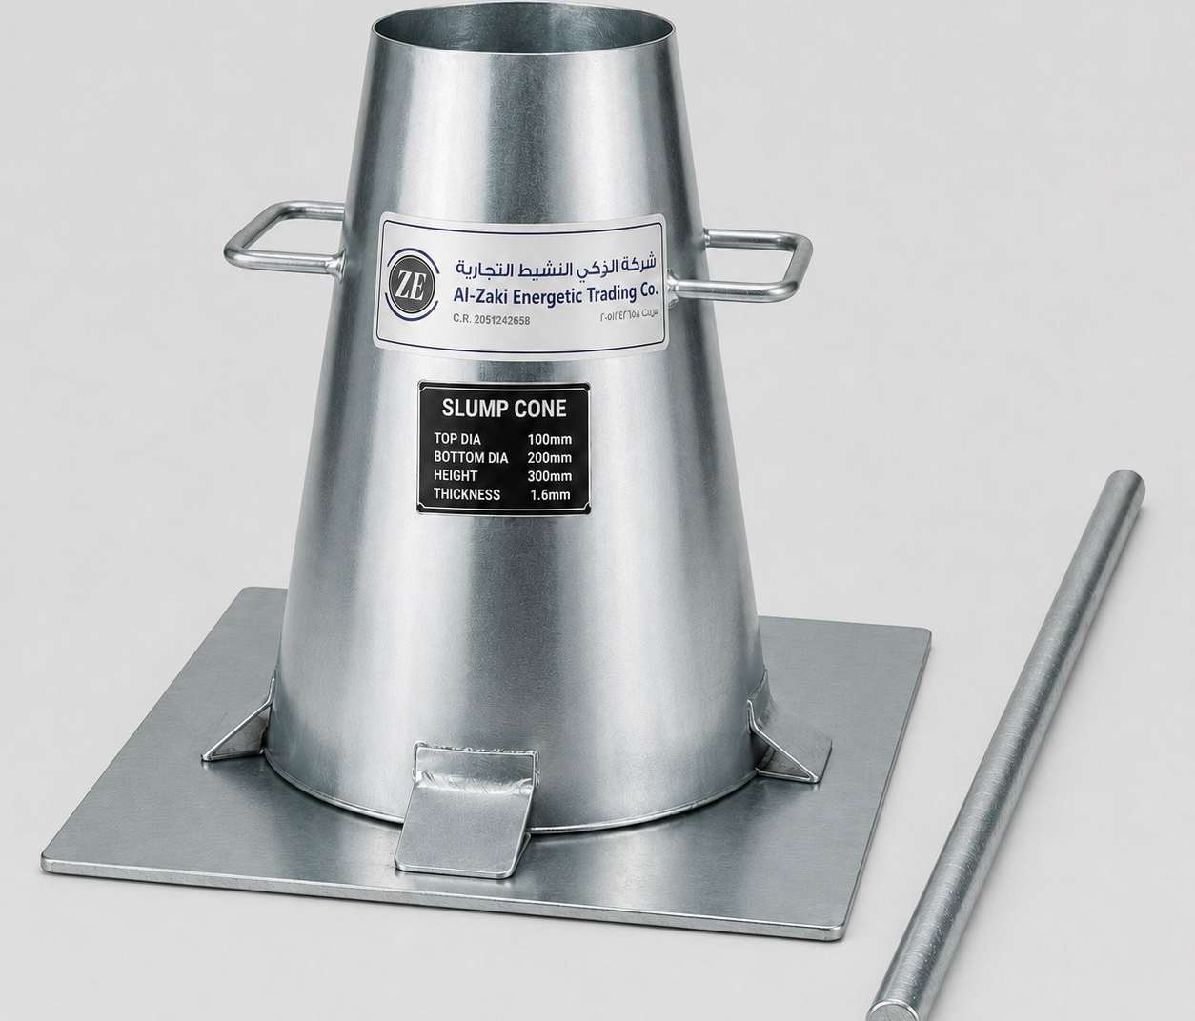
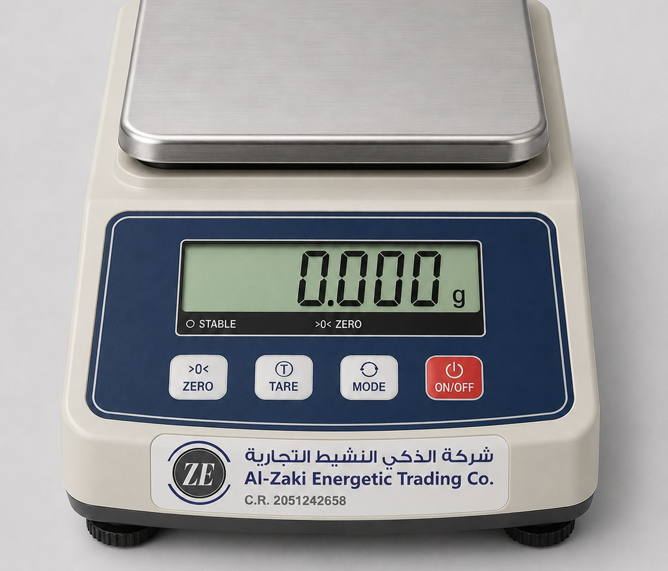
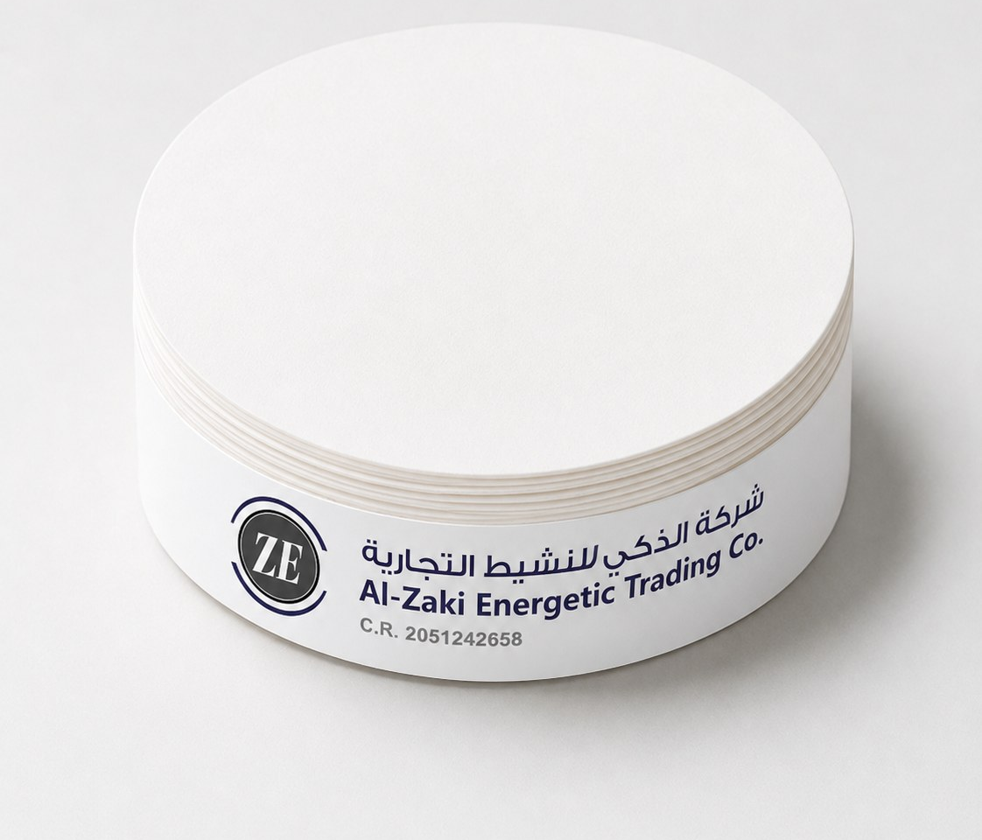
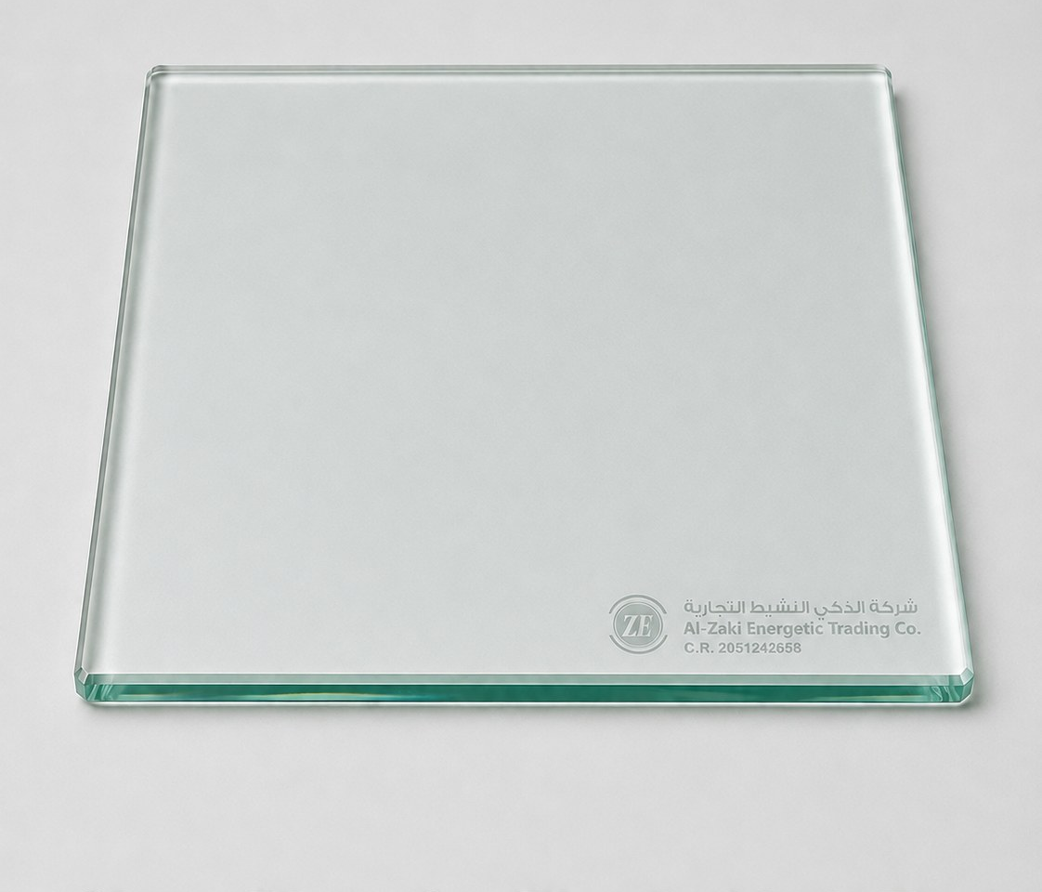
Al-Zaki Energetic Trading Co.
شركة الذكي النشيط التجارية | C.R. 2051242658
Civil Testing Equipment
Core concrete and laboratory equipment for site testing and quality-control workflows.
ZE
Slump Cone Test Set
ZE
Digital Weighing Balance
Concrete workability testing with cone, base plate and tamping rod. Suitable for site and laboratory slump checks.
Bench weighing balance for laboratory and material-testing operations. Capacity and accuracy confirmed at quotation stage.
Concrete • ASTM/BS workflows
Lab weighing • QC
ZE
Filter Papers
ZE
Glass Plate for Plastic Limit
Round filter papers for triaxial, soil, aggregate and laboratory filtration applications in common diameters.
Smooth glass plate used during plastic limit testing and soil consistency limit procedures.
Lab consumables
Soil testing
tahir@zakienergetictrading.com | faseeh@zakienergetictrading.com | sales@zakienergetictrading.com | +966 53 352 2867 | +966 55 535 9645 | www.zakienergetictrading.com
04

Slide 6
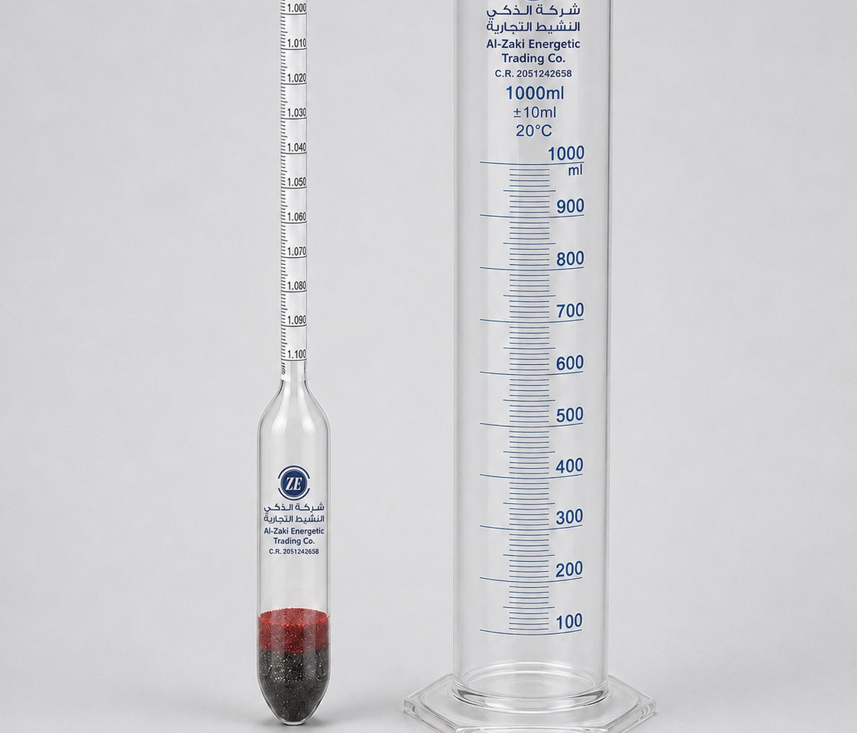
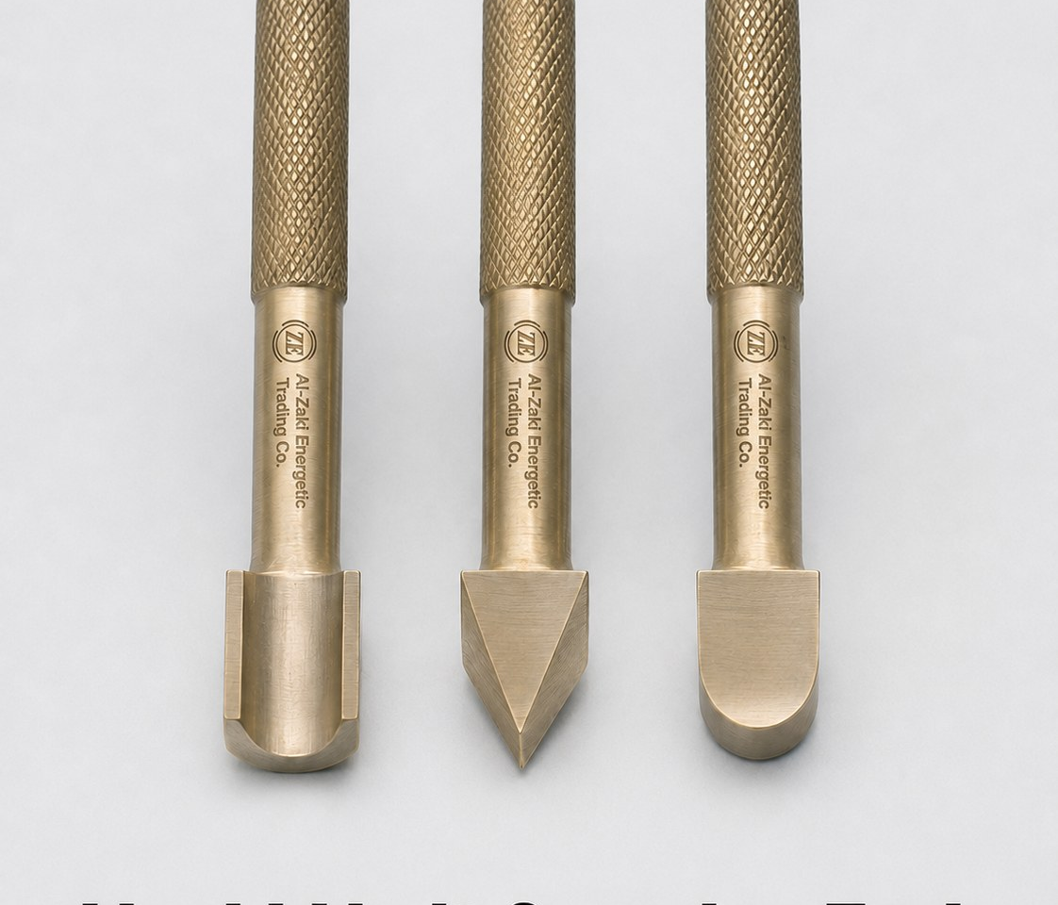
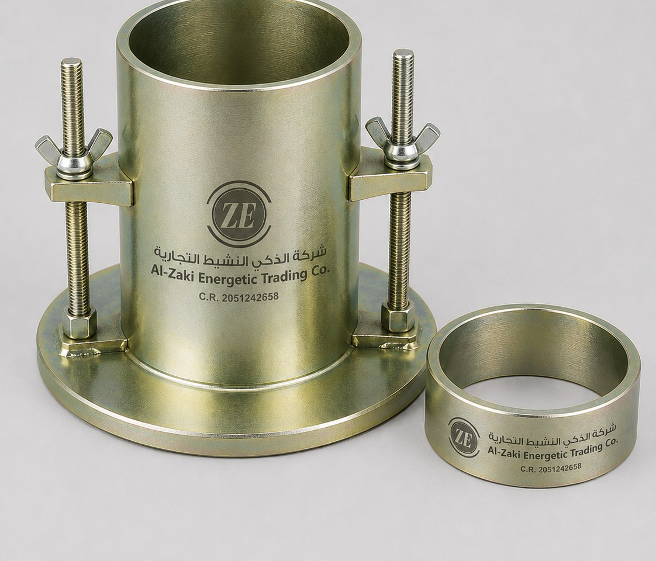
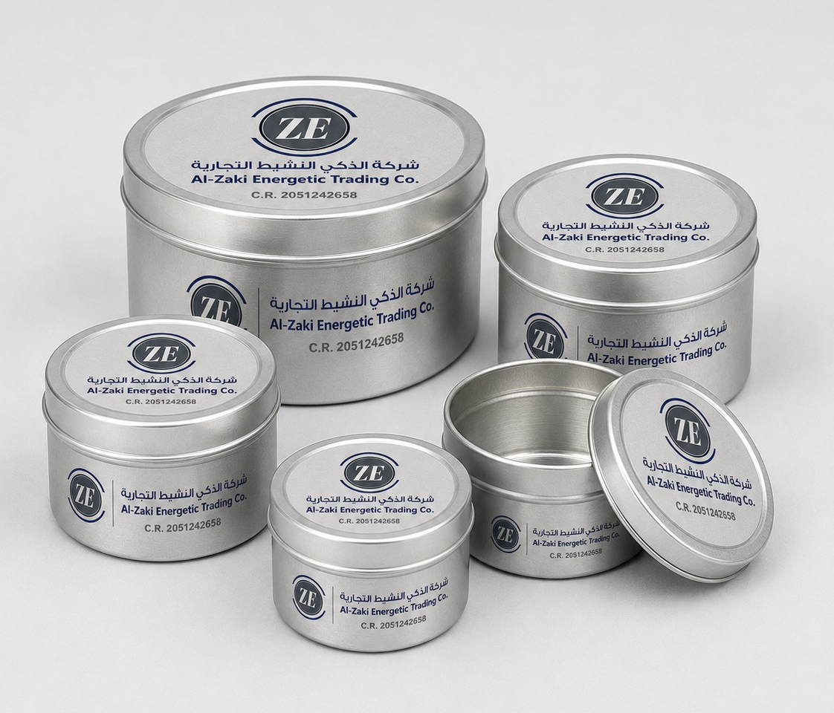
Al-Zaki Energetic Trading Co.
شركة الذكي النشيط التجارية | C.R. 2051242658
Soil, Aggregate & Cement Testing
Branded equipment for soil classification, density, compaction and material evaluation.
ZE
Hydrometer & Measuring Cylinder
ZE
Liquid Limit Grooving Tools
Hydrometer and 1000 ml cylinder set for soil particle-size analysis and sedimentation testing.
Grooving tools for liquid limit testing, supplied in common tool profiles for soil laboratory procedures.
Soil analysis
Atterberg limits
ZE
Proctor Moulds & Collars
ZE
Moisture Tins / Aluminum Containers
Standard and modified compaction moulds with collars and base plates for soil compaction tests.
Aluminum tins for oven-drying, moisture-content testing and sample storage in QC laboratories.
Soil compaction
Moisture content
tahir@zakienergetictrading.com | faseeh@zakienergetictrading.com | sales@zakienergetictrading.com | +966 53 352 2867 | +966 55 535 9645 | www.zakienergetictrading.com
05

Slide 7
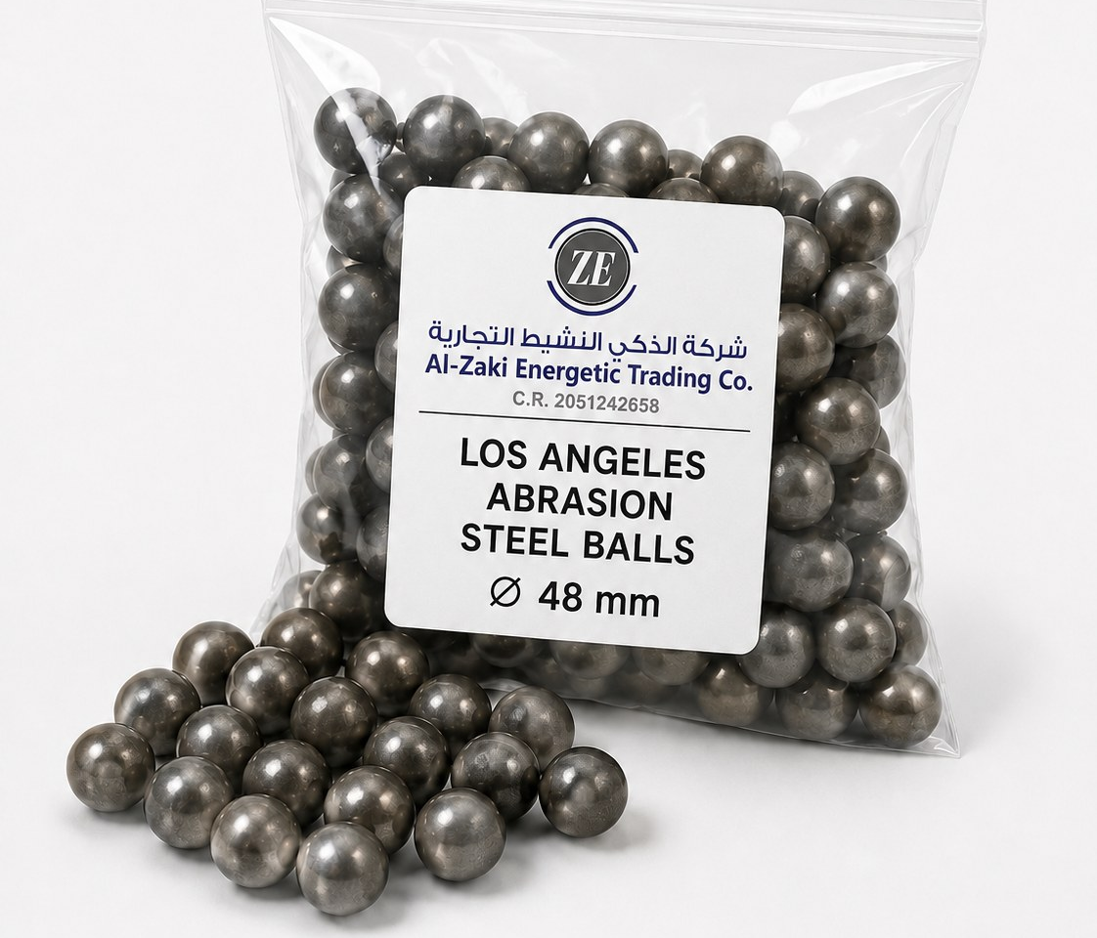
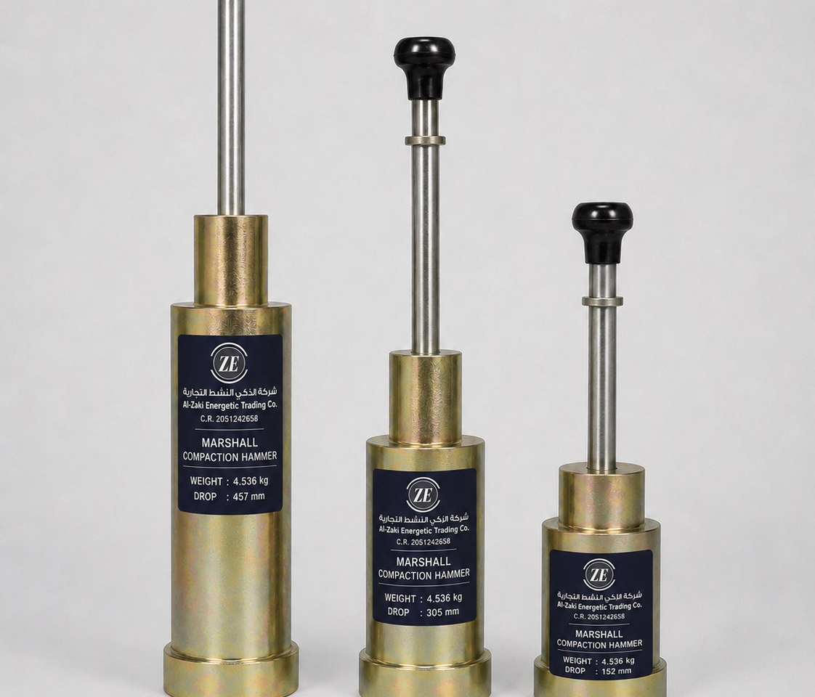
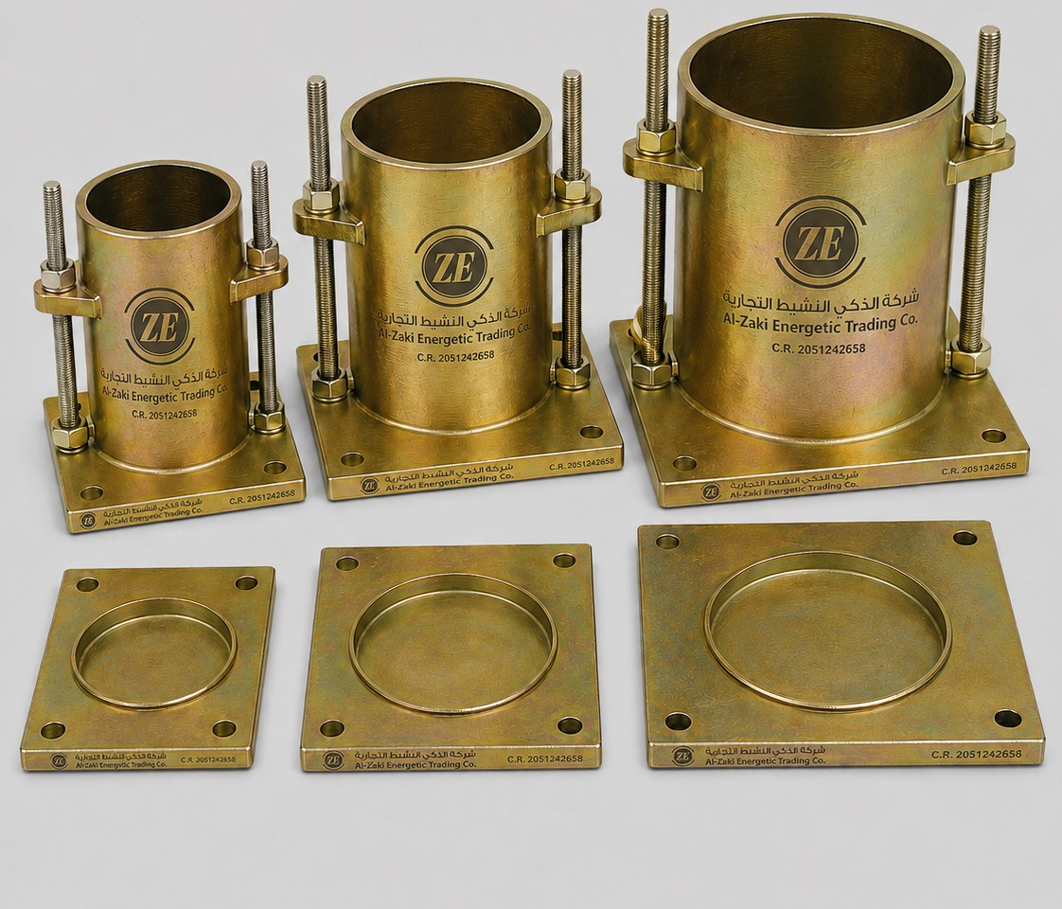
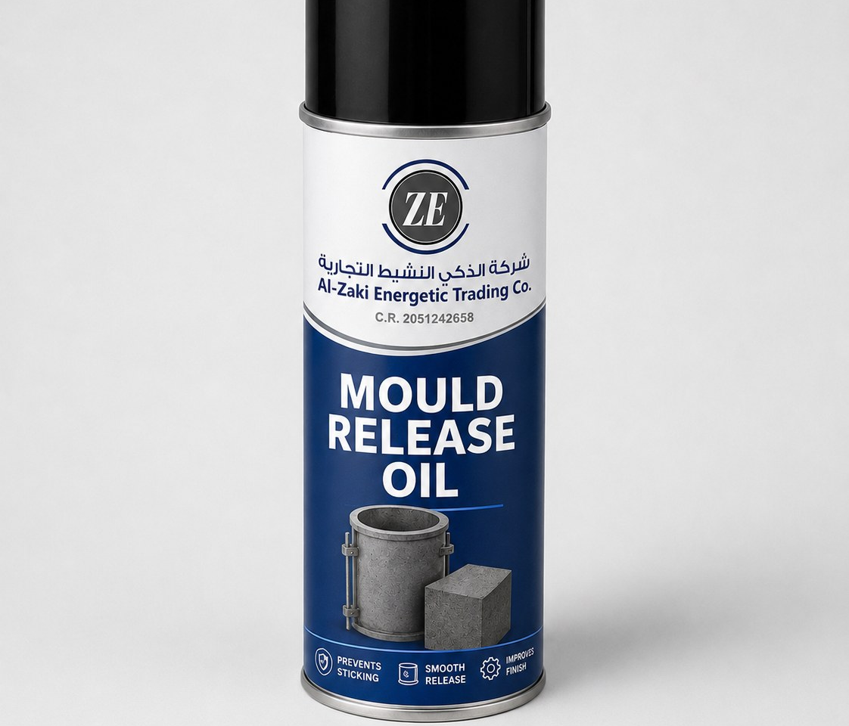
Al-Zaki Energetic Trading Co.
شركة الذكي النشيط التجارية | C.R. 2051242658
Asphalt, Bitumen & Aggregate Testing
Asphalt mix testing, aggregate abrasion checks, and bitumen-related laboratory consumables.
ZE
Los Angeles Abrasion Steel Balls
ZE
Marshall Compaction Hammers
Steel charge balls for LA abrasion tests used to evaluate aggregate resistance to wear and impact.
Manual and automatic Marshall compaction hammer options for asphalt specimen compaction.
Aggregate testing
Asphalt compaction
ZE
Marshall Moulds & Base Plates
ZE
Mould Release Oil
Marshall moulds, collars and base plates supplied in required sizes for asphalt sample preparation.
Release oil for concrete/asphalt moulds, helping reduce sticking and improve demoulding quality.
Asphalt laboratory
Consumables
tahir@zakienergetictrading.com | faseeh@zakienergetictrading.com | sales@zakienergetictrading.com | +966 53 352 2867 | +966 55 535 9645 | www.zakienergetictrading.com
06

Slide 8
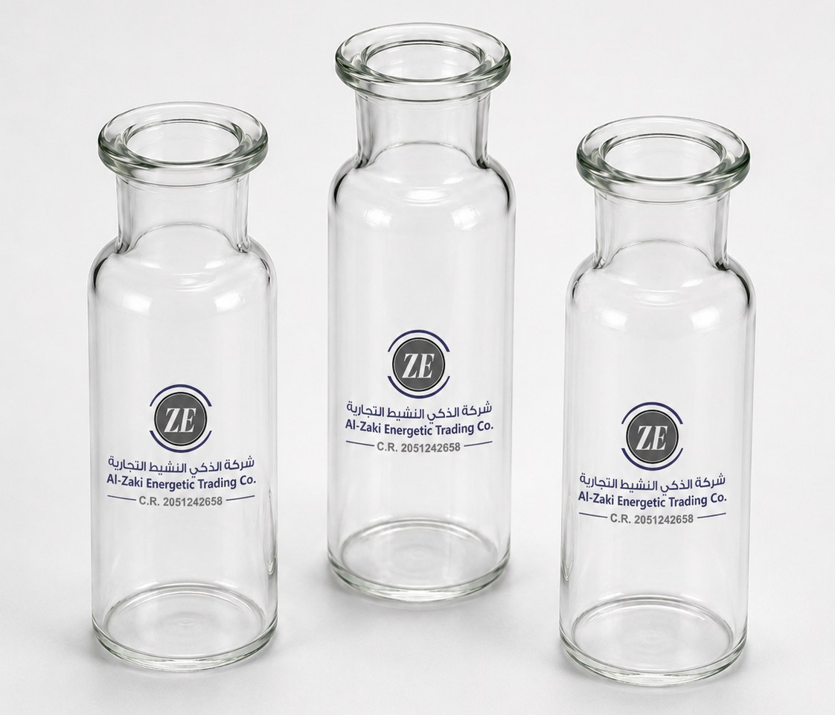
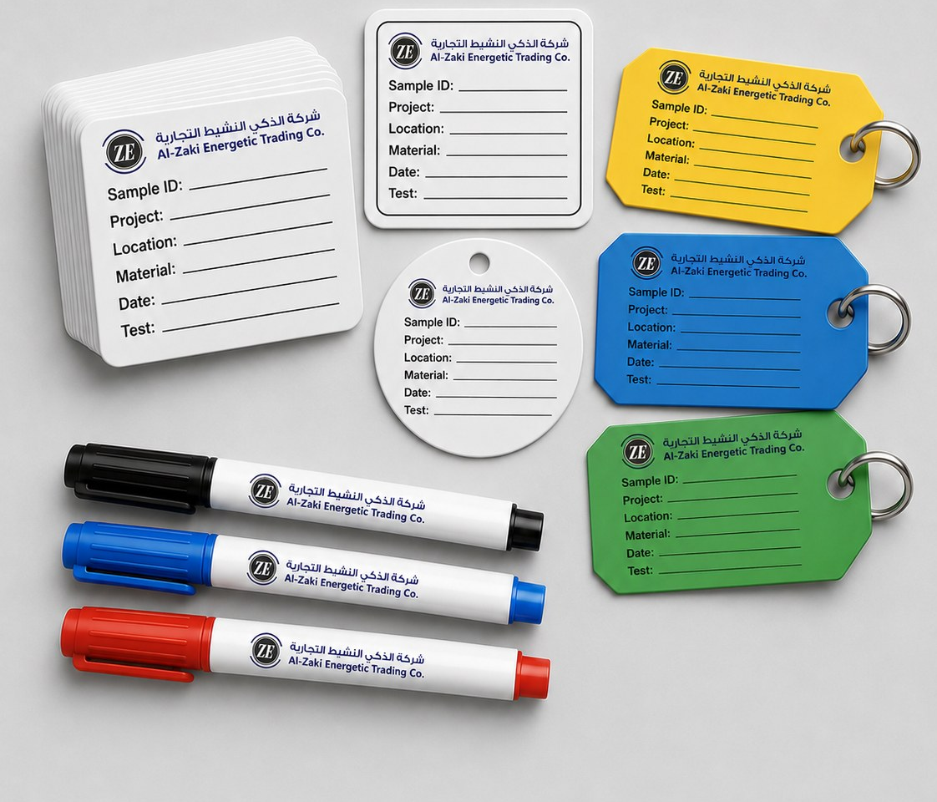
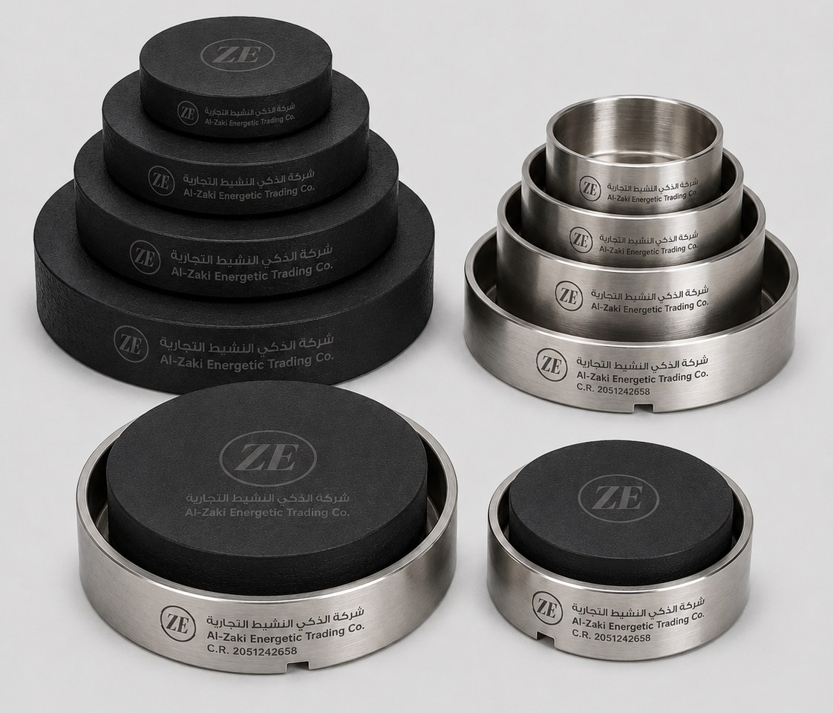
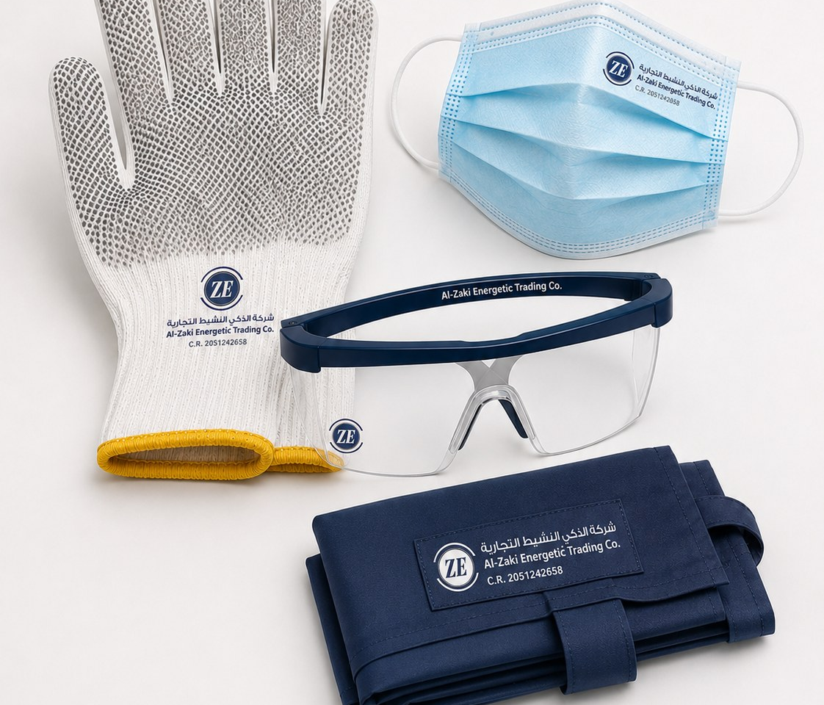
Al-Zaki Energetic Trading Co.
شركة الذكي النشيط التجارية | C.R. 2051242658
Laboratory Consumables & Safety
Consumables, sample identification, neoprene accessories and site/lab PPE support.
ZE
RTFO Bottles / Glassware
ZE
Sample Labels / Waterproof Tags
Laboratory glassware for bitumen and general testing applications; sizes and standards confirmed on request.
Branded waterproof tags, sample labels and markers for traceability in laboratory and field sampling.
Lab glassware
Sample control
ZE
Neoprene Pads & Retainers
ZE
PPE: Gloves, Masks, Goggles, Aprons
Neoprene pads and steel retainers for compression testing and concrete cylinder testing workflows.
Safety products for construction sites, workshops, laboratories and warehouse operations.
Compression testing
Safety supply
tahir@zakienergetictrading.com | faseeh@zakienergetictrading.com | sales@zakienergetictrading.com | +966 53 352 2867 | +966 55 535 9645 | www.zakienergetictrading.com
07

Slide 9
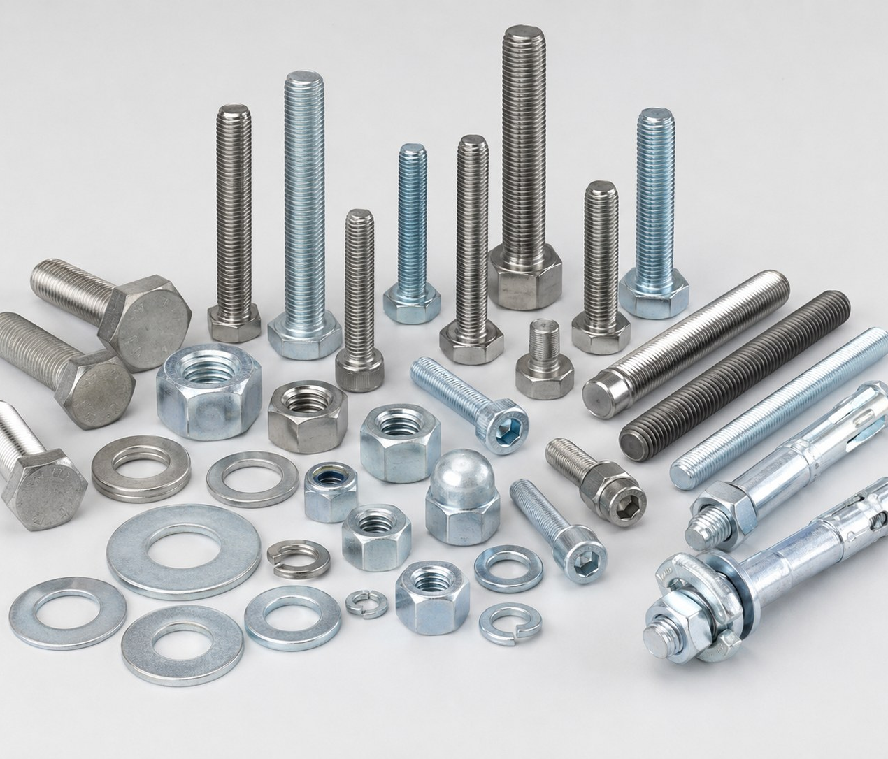
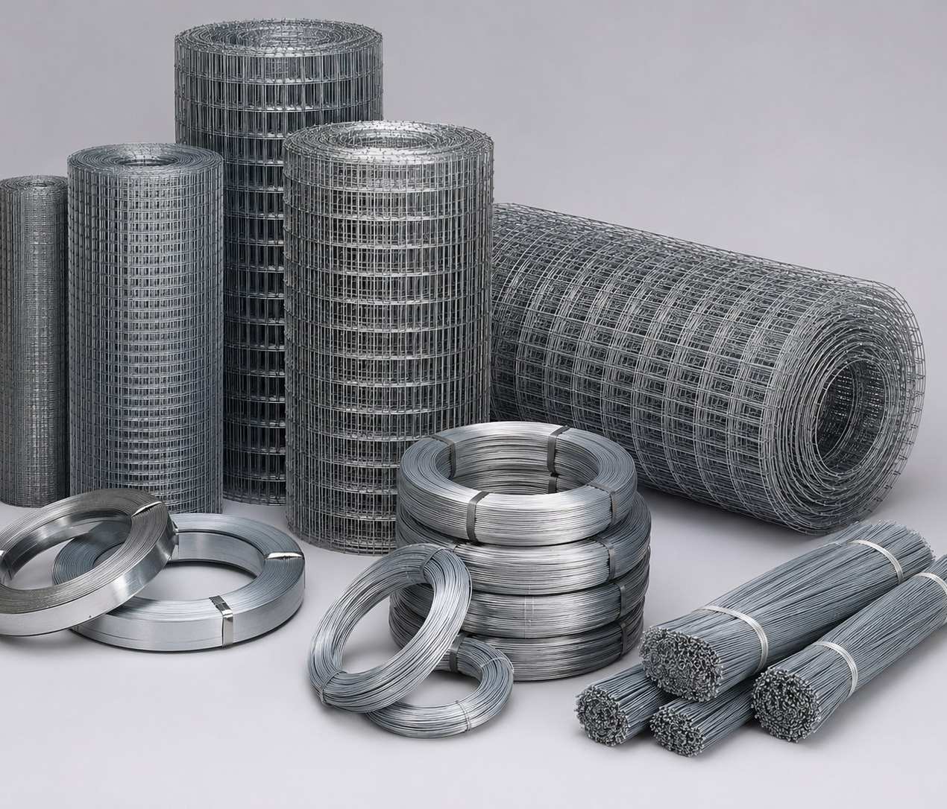
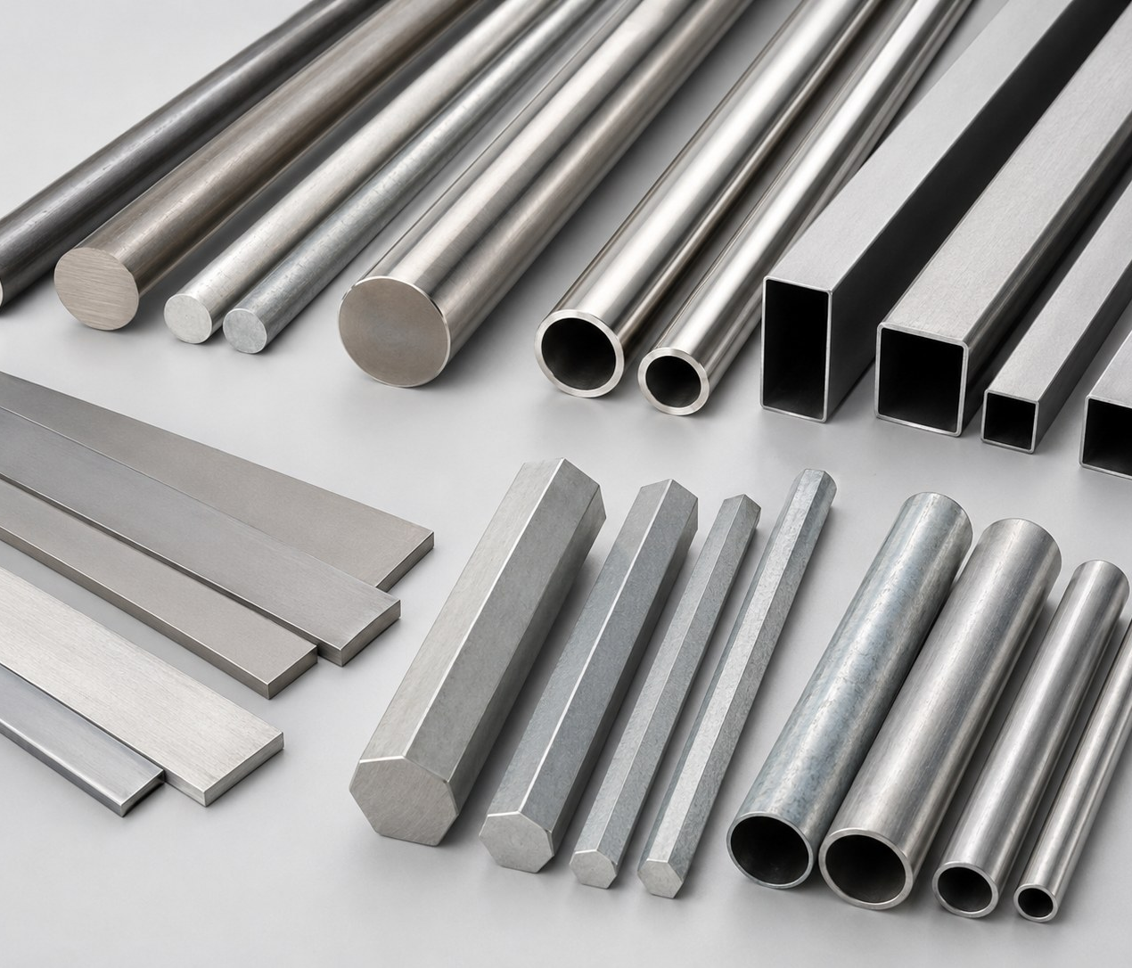
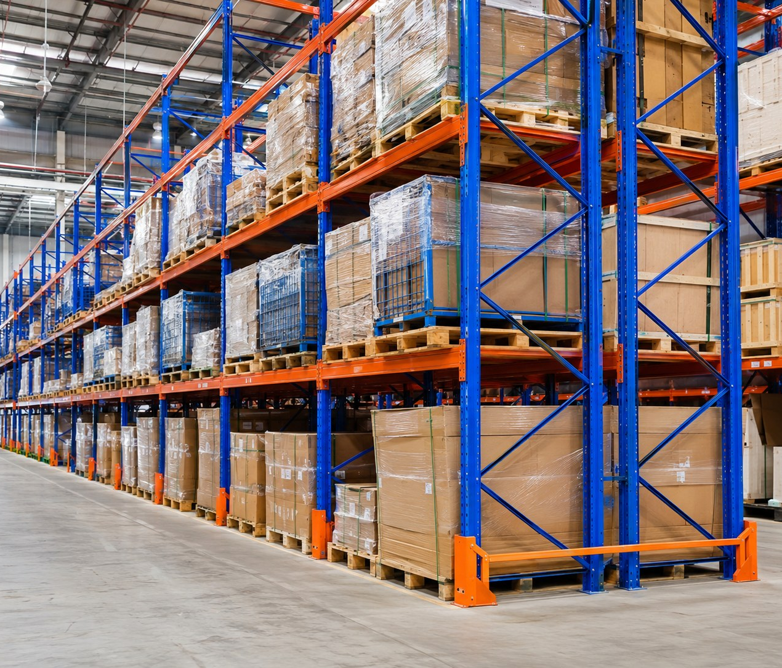
Al-Zaki Energetic Trading Co.
شركة الذكي النشيط التجارية | C.R. 2051242658
Fasteners, Wire Mesh & Steel Materials
Standard and special fasteners, wire mesh, binding straps, tie wires, bars and tubes.
ZE
Fasteners & Anchors
ZE
Wire Mesh & Binding Wires
Hex bolts, nuts, washers, threaded rods, anchors and special fasteners in SS, HDG, black, brass and copper options.
Stainless steel, galvanized, aluminium and PVC wire mesh, binding wires, coils and straps for industrial use.
Standard & special fasteners
Mesh • wire • straps
ZE
Bars & Tubes
ZE
Warehouse Stock & Bulk Supply
Round bars, flat bars, hex bars, square tubes, pipe tubes and machined materials, supplied by grade and size.
Centralized procurement, stock coordination, bulk supply and delivery planning for recurring project needs.
Metal materials
Bulk supply support
tahir@zakienergetictrading.com | faseeh@zakienergetictrading.com | sales@zakienergetictrading.com | +966 53 352 2867 | +966 55 535 9645 | www.zakienergetictrading.com
08

Slide 10
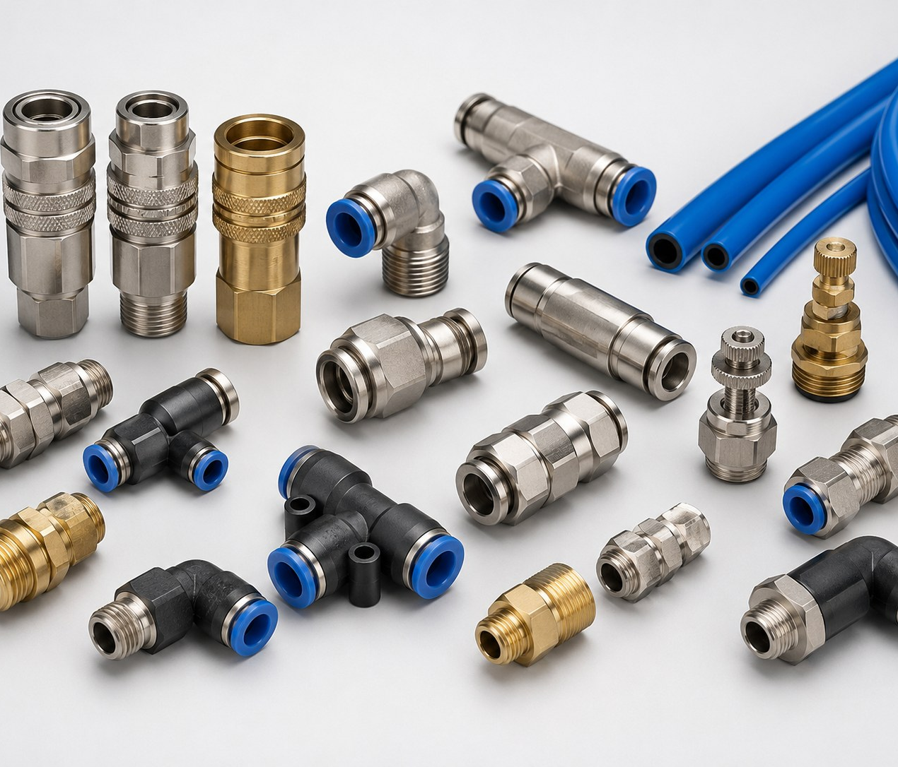
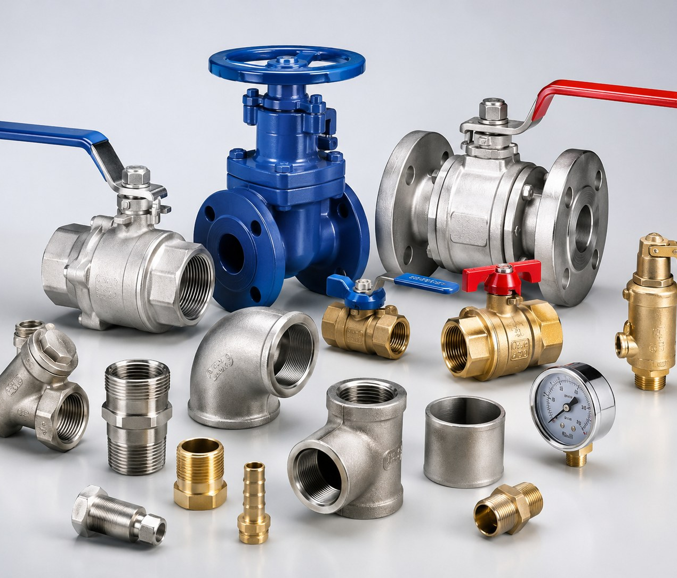
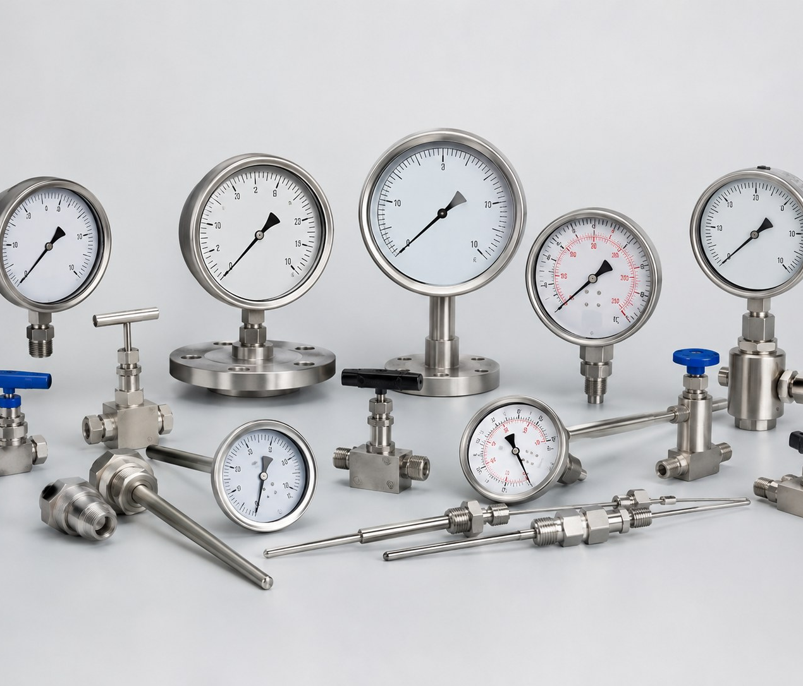
Al-Zaki Energetic Trading Co.
شركة الذكي النشيط التجارية | C.R. 2051242658
Mechanical Components, Fittings & Valves
Air fittings, valves, pipe fittings, tank mountings, gauges and plant accessories.
ZE
Air Fittings & Tubing
ZE
Valves & Pipe Fittings
Pneumatic connectors, elbows, tees, tubing, couplers and compressed-air accessories for workshops and plants.
Ball valves, gate valves, threaded fittings, flanges, adapters and general piping accessories.
Pneumatics
Plant utilities
ZE
Pressure & Temperature Gauges
ZE
Tubes, Bars & Mechanical Parts
Pressure gauges, temperature gauges and accessories for utility, HVAC and process monitoring.
Metal tubes, bars, machined components and mechanical consumables sourced to technical specification.
Instrumentation
Mechanical supply
tahir@zakienergetictrading.com | faseeh@zakienergetictrading.com | sales@zakienergetictrading.com | +966 53 352 2867 | +966 55 535 9645 | www.zakienergetictrading.com
09

Slide 11
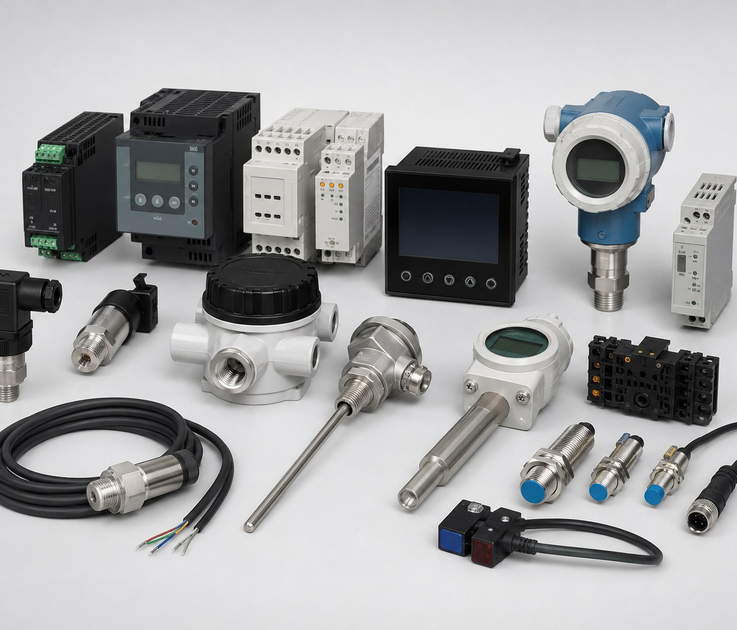
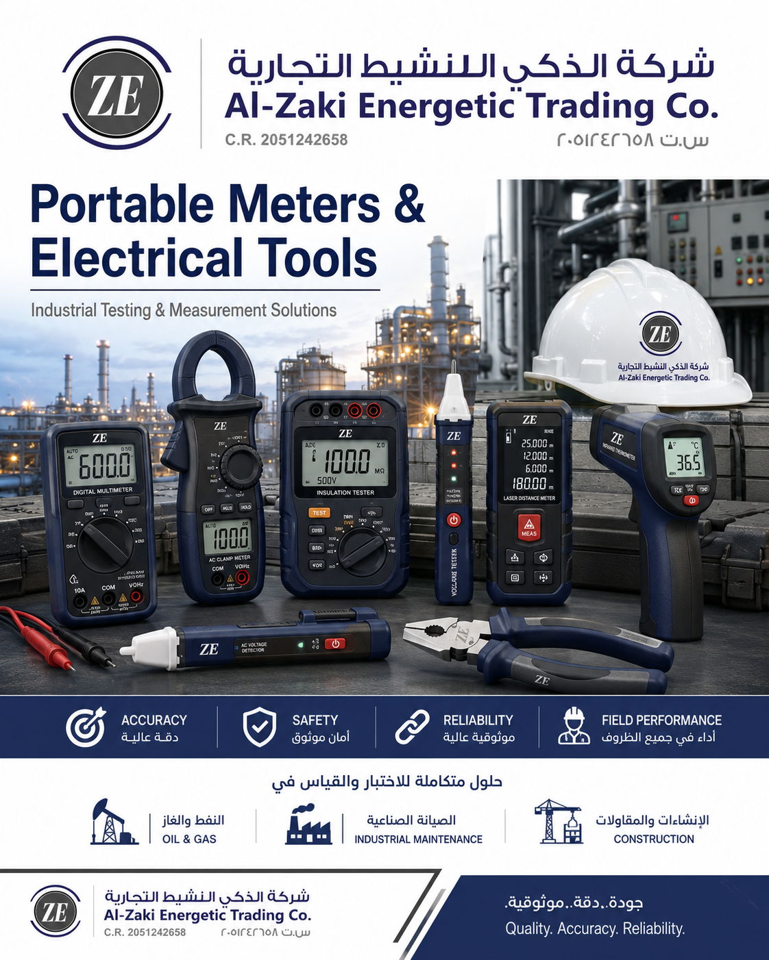
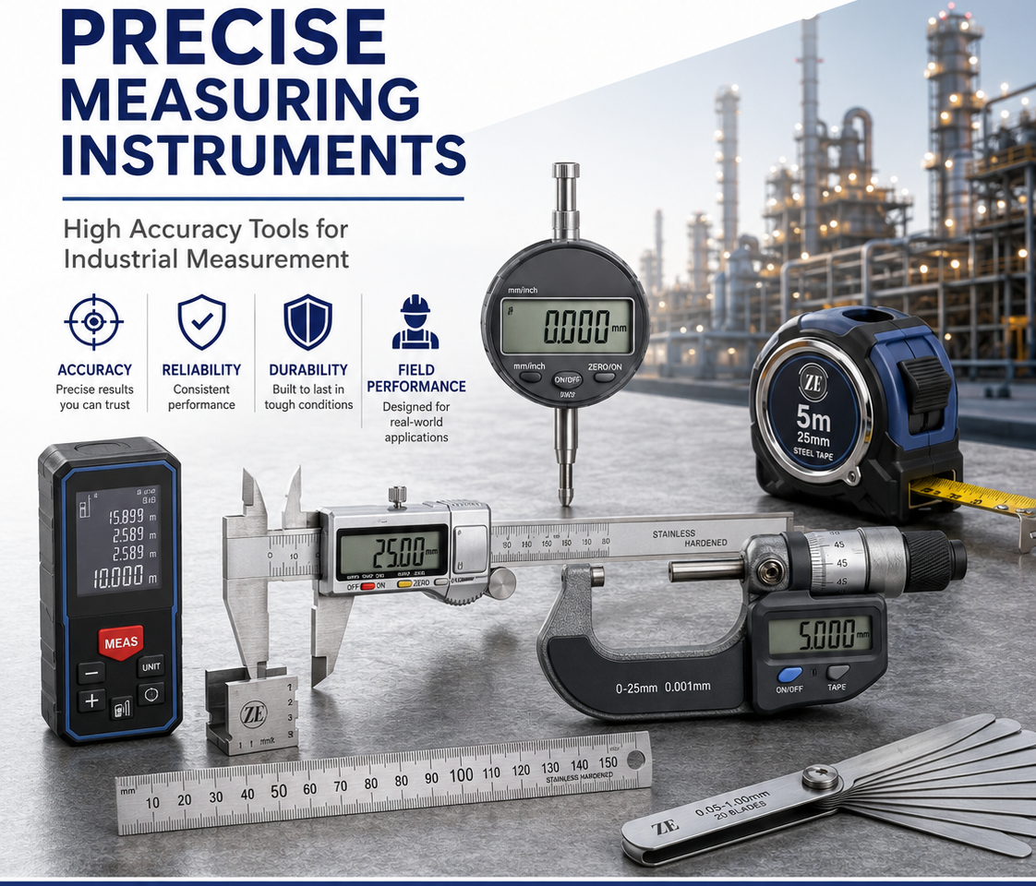
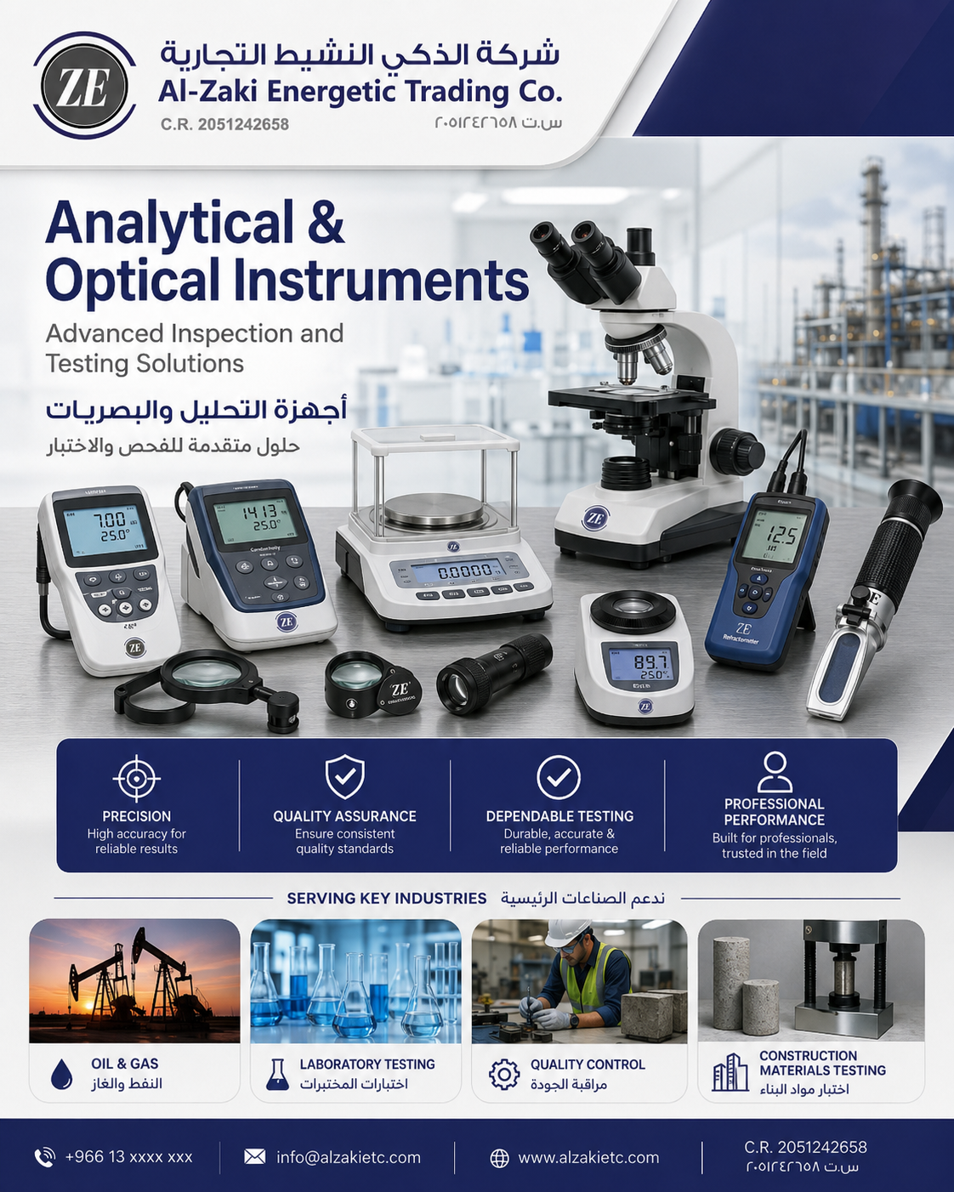
Al-Zaki Energetic Trading Co.
شركة الذكي النشيط التجارية | C.R. 2051242658
Automation, Instruments & Measuring
Sensors, switches, transmitters, controllers, portable meters, scales and precision tools.
Sensors, Switches & Transmitters
ZE
Portable Meters & Electrical Tools
Temperature sensors, pressure switches, transmitters, controllers, relays, limit switches and control modules.
Multimeters, clamp meters, thermal meters and portable instruments for maintenance and testing teams.
Automation components
Meters & tools
ZE
Precise Measuring Instruments
Analytical & Optical Instruments
Calipers, micrometers, dial indicators, balances and measuring accessories for inspection and QC.
Microscopes, laboratory balances, optical measurement and analytical instruments matched to application needs.
Inspection & QC
Lab instruments
tahir@zakienergetictrading.com | faseeh@zakienergetictrading.com | sales@zakienergetictrading.com | +966 53 352 2867 | +966 55 535 9645 | www.zakienergetictrading.com
10

Slide 12
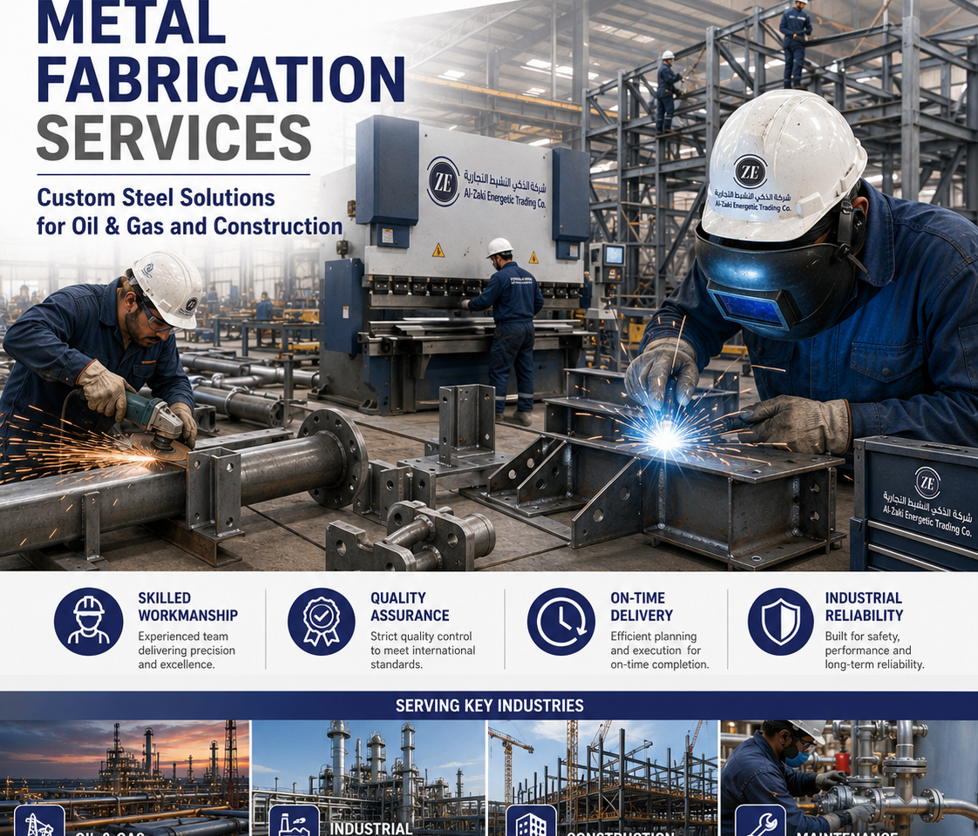
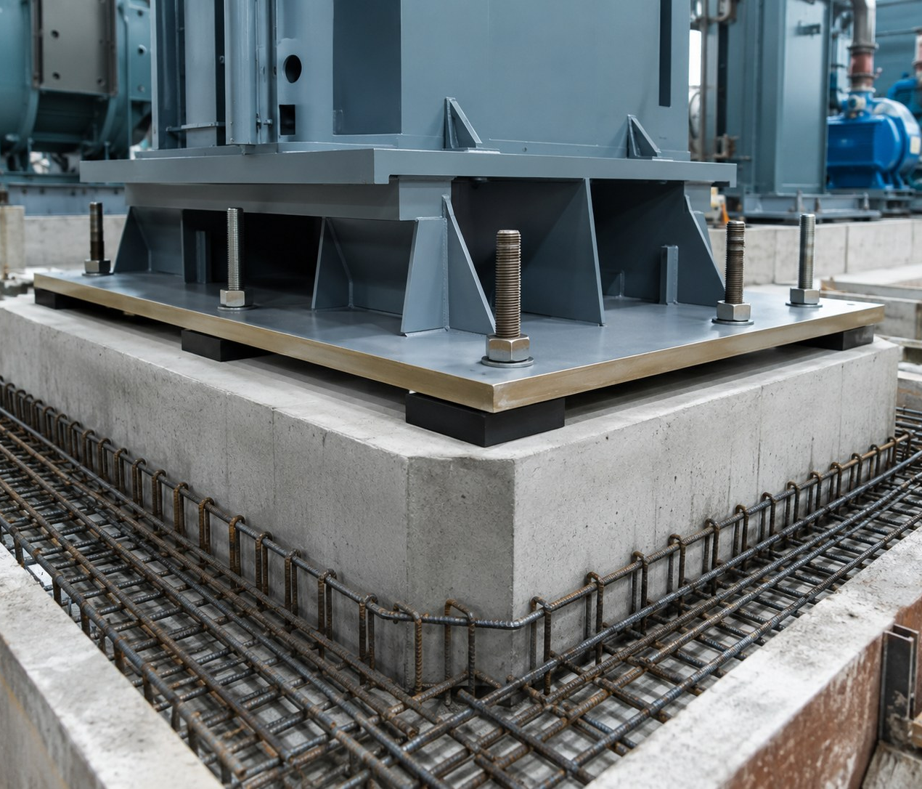
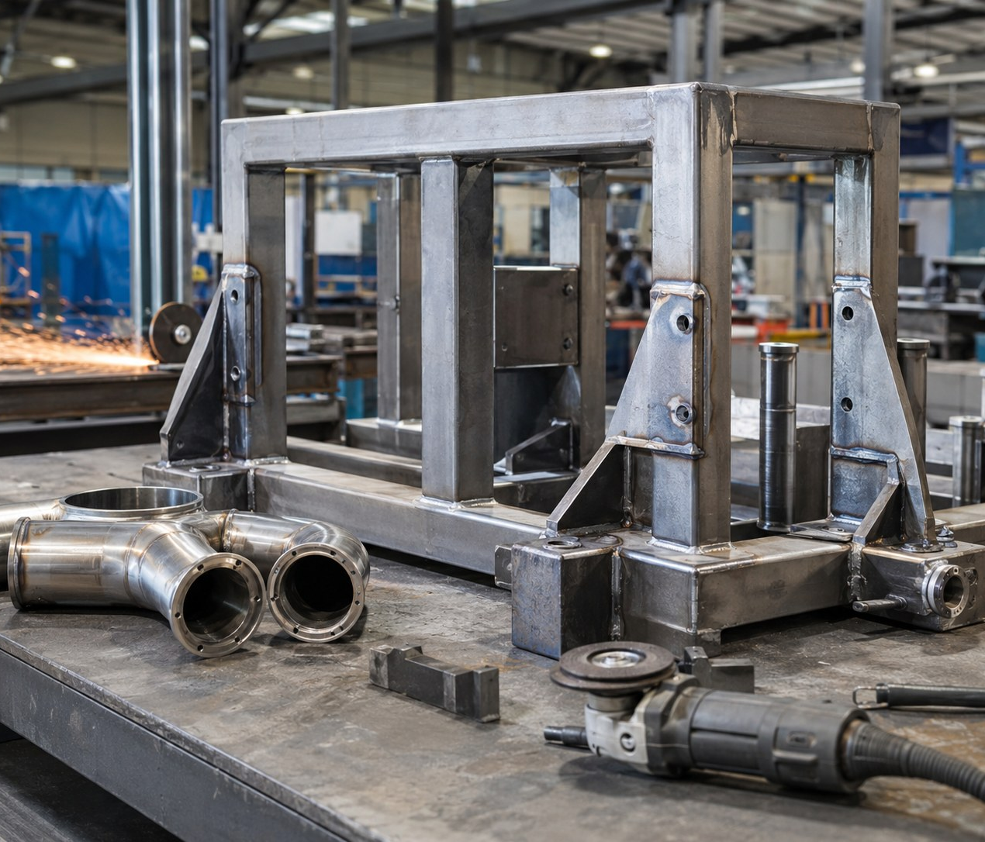
Al-Zaki Energetic Trading Co.
شركة الذكي النشيط التجارية | C.R. 2051242658
Fabrication & Civil Works Support
Metal fabrication, machine foundations, civil work supply and fabricated industrial products.
Metal Fabrication Services
ZE
Civil Machine Foundations
Fabricated frames, supports, brackets, custom steel components, welding and workshop coordination.
Foundation accessories, base plates, anchor bolts, grout support and machinery installation supply coordination.
Fabrication support
Civil works
ZE
Fabrication Products
ZE
Warehouse Racks & Storage
Custom brackets, supports, collars, frames, machined plates, guards and project-based fabricated items.
Racking systems, storage supports, warehouse consumables and industrial stock-management support.
Made-to-spec
Warehouse supply
tahir@zakienergetictrading.com | faseeh@zakienergetictrading.com | sales@zakienergetictrading.com | +966 53 352 2867 | +966 55 535 9645 | www.zakienergetictrading.com
11

Slide 13
Al-Zaki Energetic Trading Co.
شركة الذكي النشيط التجارية | C.R. 2051242658
HVAC, Plant Accessories & General Supply
HVAC consumables, fittings, instruments, hardware, office supplies and general industrial items.
ZE
HVAC Items & Accessories
ZE
Tank Mountings & Accessories
HVAC valves, insulation accessories, tapes, fittings, duct consumables and utility components.
Level, pressure and temperature accessories, tank mountings, gauges and instrumentation items.
HVAC supply
Tank accessories
ZE
Hardware Items
ZE
Office Equipment & Supplies
Tools, drill bits, cutting discs, hoses, shim plates, clamps, tags, filters and general hardware consumables.
Office consumables, labels, tags, markers, stationery and procurement support for project documentation.
Hardware
Office & project supplies
tahir@zakienergetictrading.com | faseeh@zakienergetictrading.com | sales@zakienergetictrading.com | +966 53 352 2867 | +966 55 535 9645 | www.zakienergetictrading.com
12

Slide 14
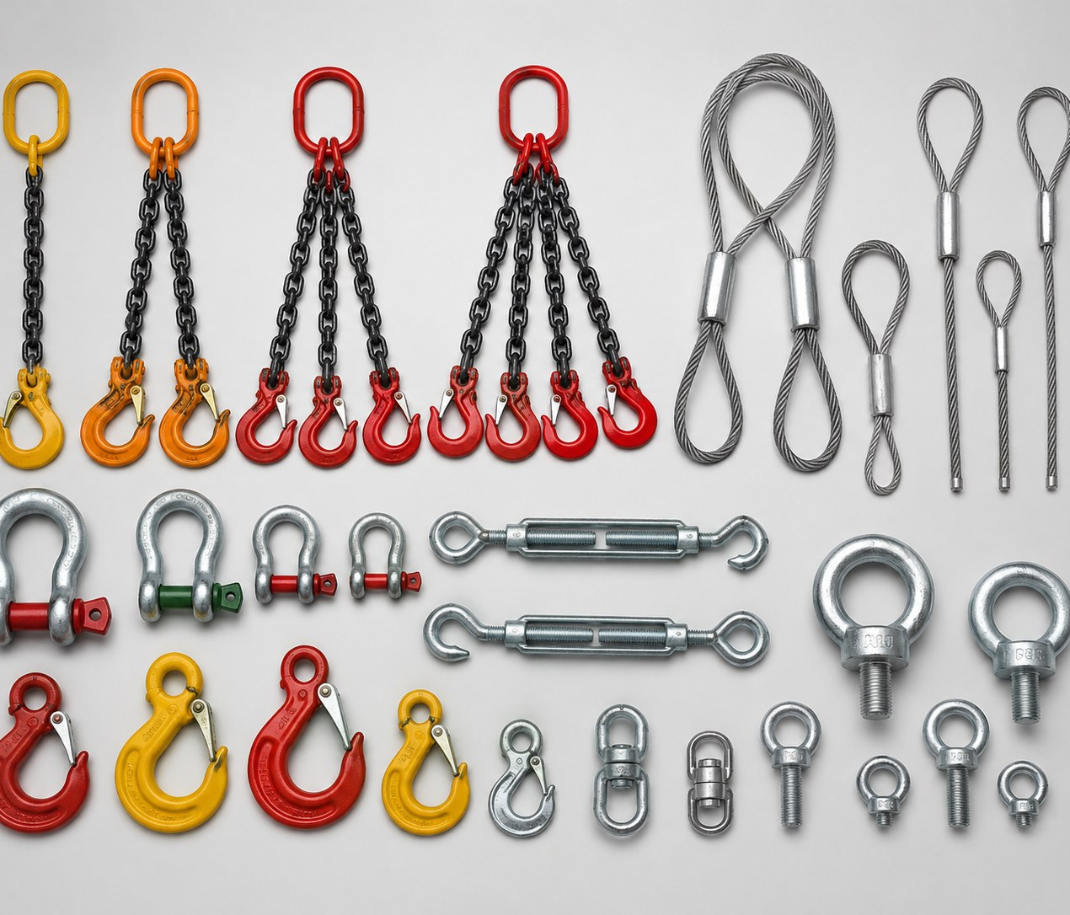
Al-Zaki Energetic Trading Co.
شركة الذكي النشيط التجارية | C.R. 2051242658
Safety, Lifting & Site Supplies
PPE, lifting gear, site safety items, labels and practical field consumables.
ZE
Safety Products / PPE
ZE
Lifting Items
Gloves, helmets, boots, vests, goggles, aprons, masks and site safety products for contractors and workshops.
Wire rope, slings, chains, shackles, hooks, eye bolts, turnbuckles and rigging accessories.
PPE supply
Lifting & rigging
ZE
Sample Tags & Field Labels
ZE
Industrial Consumables
Durable labels and waterproof tags for field sampling, inspections, maintenance and traceability systems.
Mould release oil, filters, tapes, washers, consumables and daily-use support items for plant/site operations.
Traceability
Consumables
tahir@zakienergetictrading.com | faseeh@zakienergetictrading.com | sales@zakienergetictrading.com | +966 53 352 2867 | +966 55 535 9645 | www.zakienergetictrading.com
13

Slide 15
Al-Zaki Energetic Trading Co.
شركة الذكي النشيط التجارية | C.R. 2051242658
Services & Procurement Support
Structured sourcing from inquiry to delivery with practical technical support.
Product Sourcing
Technical Product Matching
Bulk Supply & Logistics
Identify suitable products and suppliers based on specification, application, brand preference, documentation requirement and delivery target.
Match grade, size, measuring range, standard, material finish and application so buyers avoid wrong-item purchases.
Coordinate repeat requirements, MOQ, packing, lead time, dispatch route, destination delivery and follow-up.
1
Send Inquiry
2
Share Specs
3
Receive Quotation
Product name, application or photo.
Grade, standard, size/range and quantity.
Price, lead time, origin and terms.
RFQ
READY
4
Confirm Order
5
Dispatch / Delivery
6
After-Sales Support
PO, payment terms and delivery plan.
Packing, shipment and destination handover.
Documents, warranty or parts follow-up.
tahir@zakienergetictrading.com | faseeh@zakienergetictrading.com | sales@zakienergetictrading.com | +966 53 352 2867 | +966 55 535 9645 | www.zakienergetictrading.com
14

Slide 16
Al-Zaki Energetic Trading Co.
شركة الذكي النشيط التجارية | C.R. 2051242658
Quality, Compliance & Document Readiness
A practical quality approach for industrial procurement and tender supply chains.
Quality Approach
Why Choose Al-Zaki
Trusted Supply Mindset
✓ Product standards: ASTM, BS, EN, ISO, SASO or project-specific standards to be confirmed per item
✓ Supplier datasheets, certificates, country of origin and warranty details requested where available
✓ Inspection/sample approval recommended for customized equipment and high-risk consumables
✓ Catalog placeholders are updated before tender submission or final quotation
✓ Wide product range across lab, civil, mechanical, electrical, instrumentation and safety
✓ Competitive pricing based on specification, quantity and logistics reality
✓ Technical support to clarify application and reduce rework
✓ Saudi/GCC procurement awareness with practical delivery coordination
✓ Responsive quotation workflow
✓ Bulk and repeat-order capability
✓ Long-term supply relationship focus
✓ Clear communication from inquiry to after-sales follow-up
Documentation is confirmed at quotation/order stage: datasheet, COC/COA, origin, warranty, SASO/SABER requirement and supplier/manufacturer certificates where applicable.
tahir@zakienergetictrading.com | faseeh@zakienergetictrading.com | sales@zakienergetictrading.com | +966 53 352 2867 | +966 55 535 9645 | www.zakienergetictrading.com
15

Slide 17
Al-Zaki Energetic Trading Co.
شركة الذكي النشيط التجارية | C.R. 2051242658
Industries & Client Sectors
Built for Saudi Arabia’s contractors, industrial plants, laboratories and procurement teams.
Civil Contractors
QC Laboratories
Manufacturing Plants
Oil, Gas & Industrial
Concrete, aggregate, soil, asphalt and site consumables.
Material testing equipment, glassware, balances and consumables.
Pneumatics, automation, valves, gauges, safety and hardware.
Fasteners, fittings, instrumentation, fabrication and project supply.
Warehouses
Government & Private Projects
Mechanical Contractors
Ship Chandlers & Traders
Racking, lifting items, safety, labels and maintenance consumables.
Structured RFQ support, documentation and delivery coordination.
Valves, fittings, tubes, bars, gauges and fabricated supports.
Bulk industrial items, hardware, fasteners and consumables.
Typical RFQ inputs: item name, size/range, material/grade, standard, quantity, delivery city, required certificates and target delivery date.
tahir@zakienergetictrading.com | faseeh@zakienergetictrading.com | sales@zakienergetictrading.com | +966 53 352 2867 | +966 55 535 9645 | www.zakienergetictrading.com
16

Slide 18
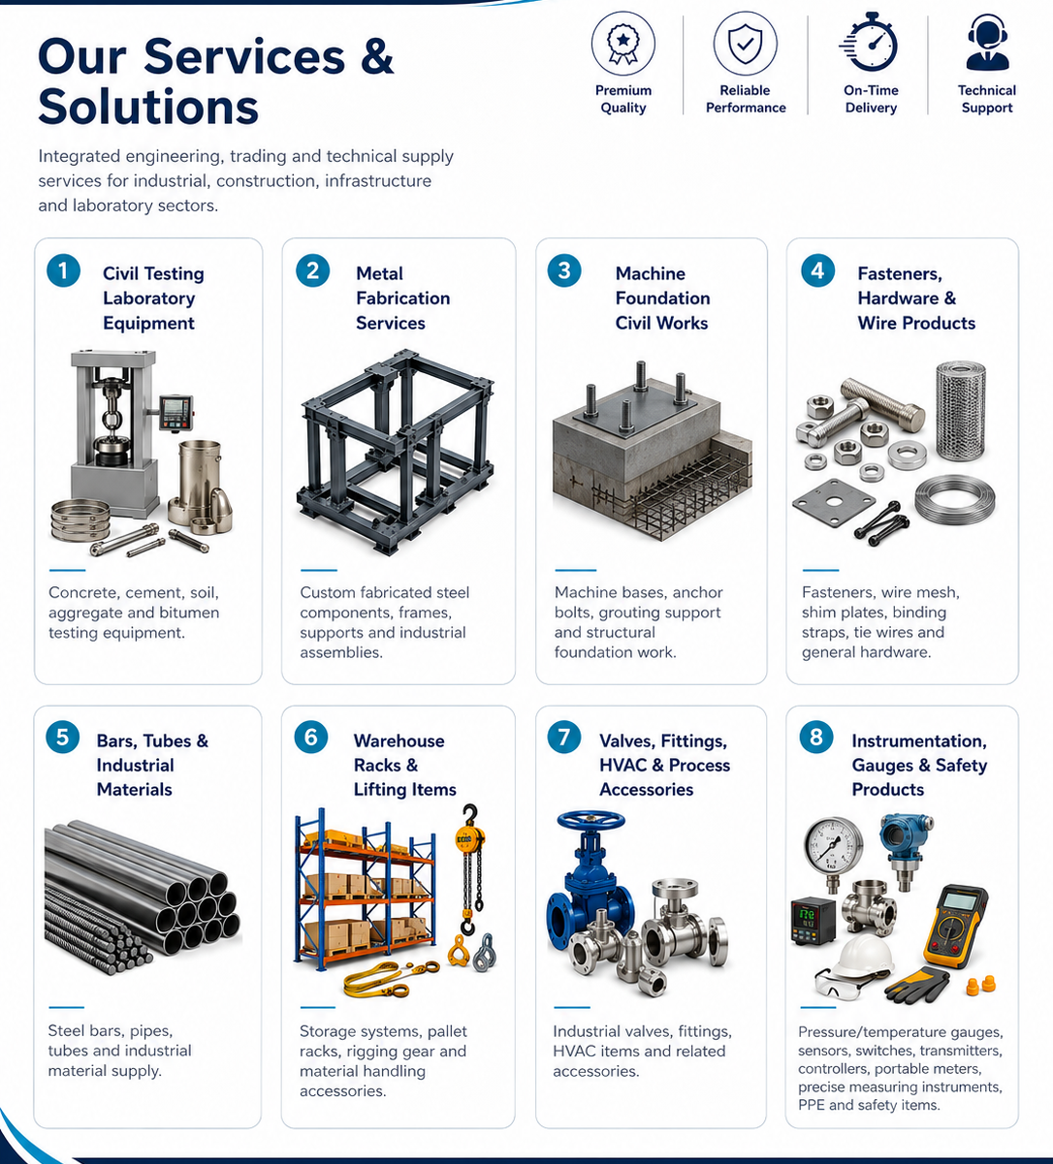
Contact Us for Quotation
Send your inquiry with product name, specification/grade, quantity, delivery location and required documents. We will review and respond with clear quotation terms.
Emails
tahir@zakienergetictrading.com
faseeh@zakienergetictrading.com
sales@zakienergetictrading.com
Phone
+966 53 352 2867 | +966 55 535 9645
Website
www.zakienergetictrading.com
Address
4th St, Al-Thuqbah, Al Khobar 31952, Kingdom of Saudi Arabia
Reliable Quality. Trusted Solutions. Built for Saudi Arabia.

